Slide 1

Milk POWDER Oscar Dowson o.dowson@auckland.ac.nz Andy Philpott, Andrew Mason, Anthony Downward

Slide 2
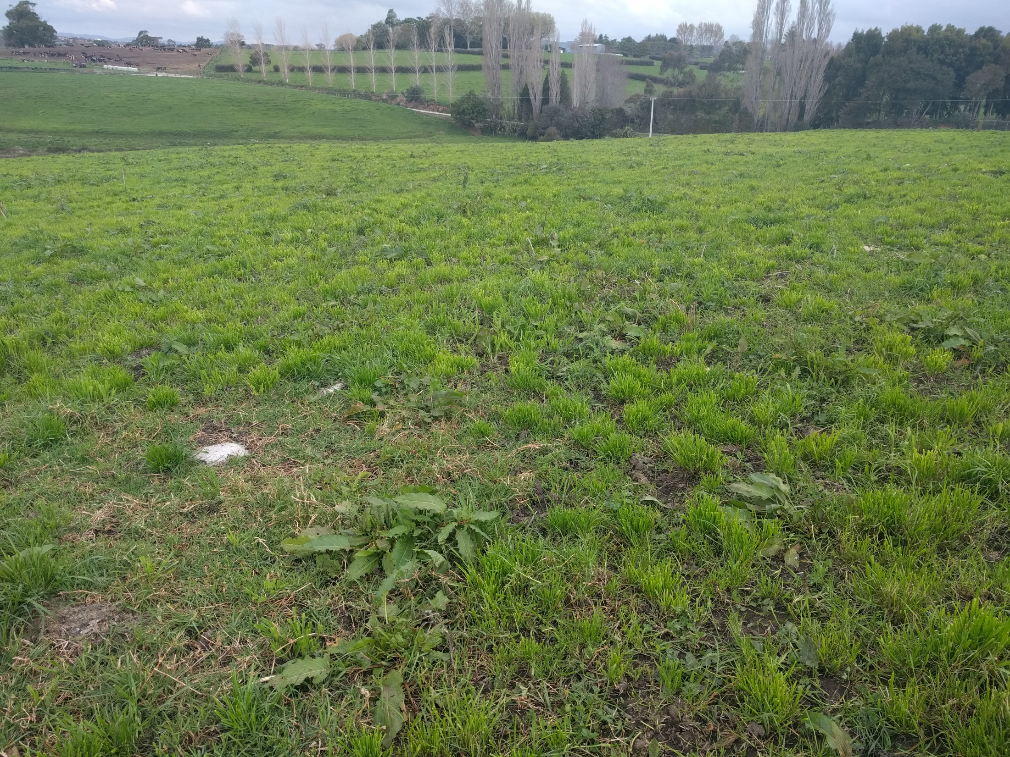

Slide 3
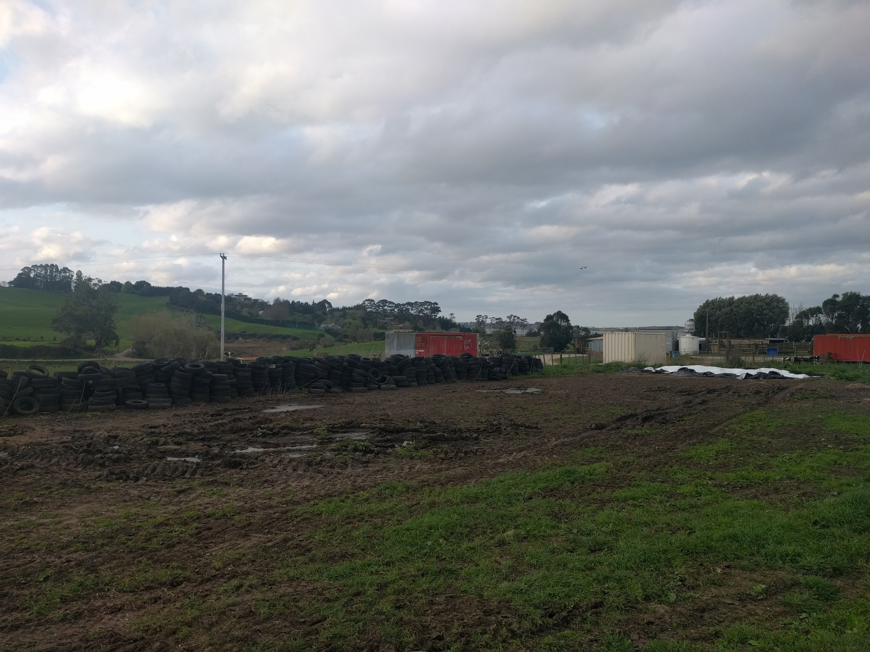

Slide 4
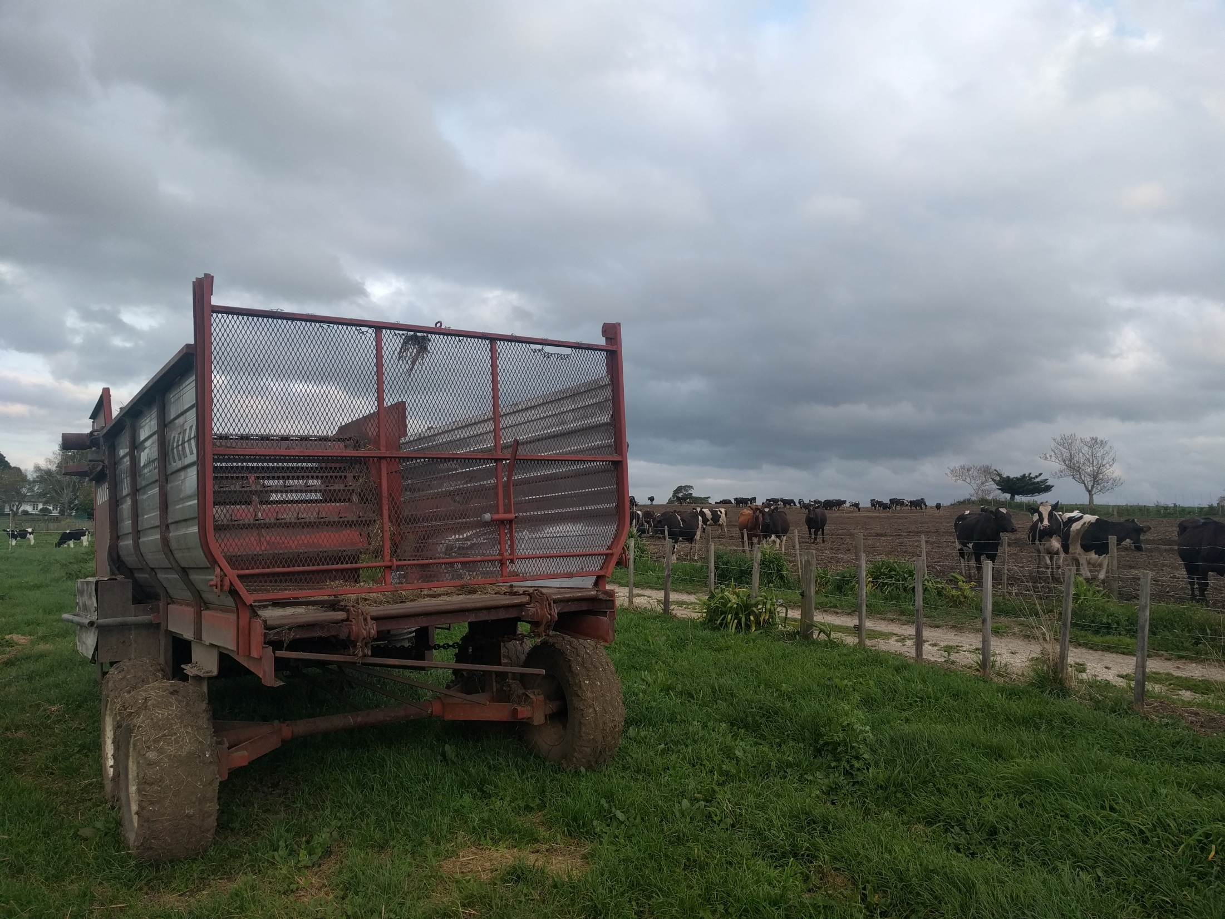
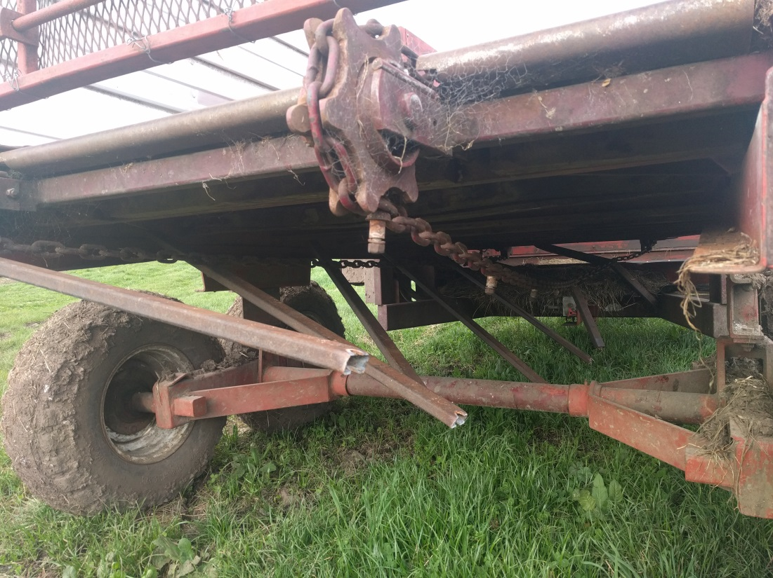

Slide 5
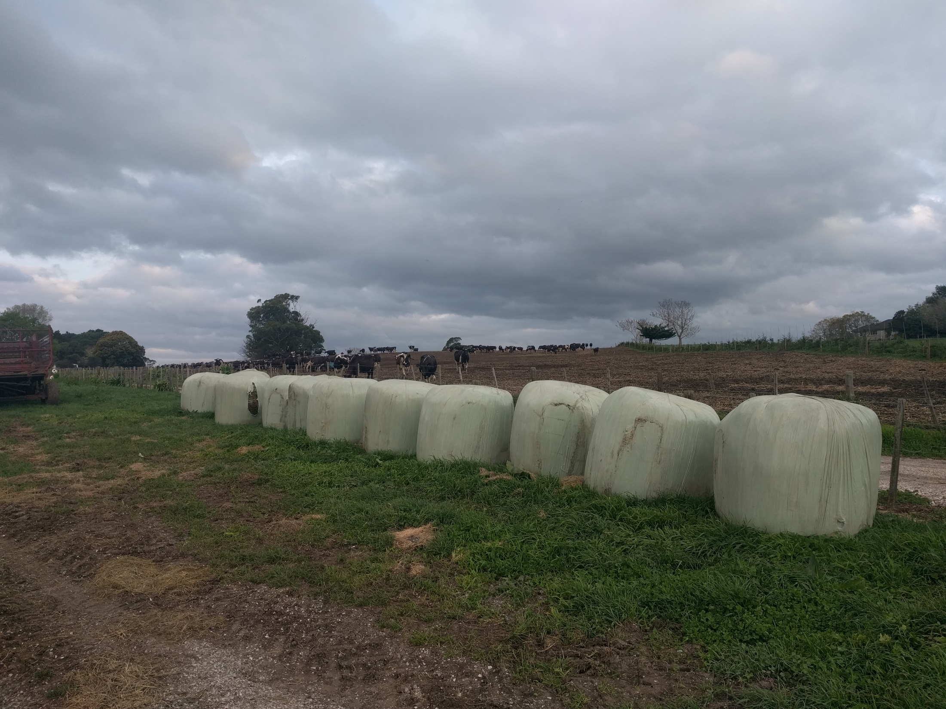

Slide 6
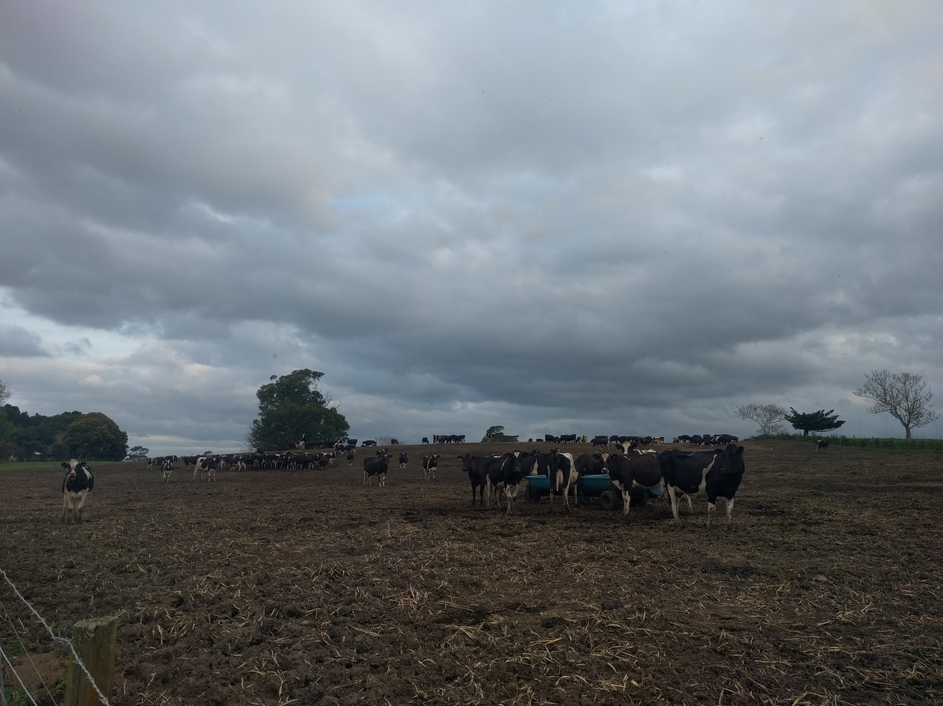

Slide 7
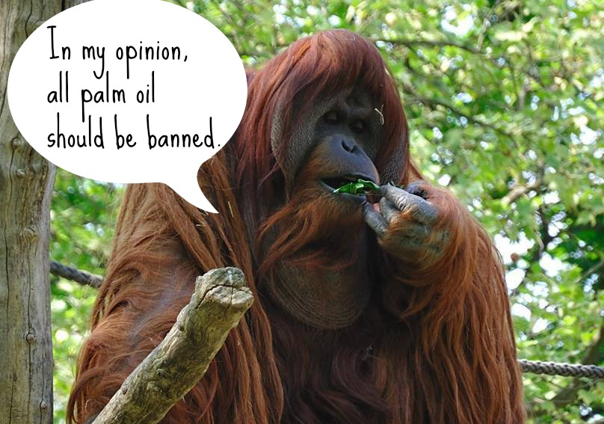

Slide 8
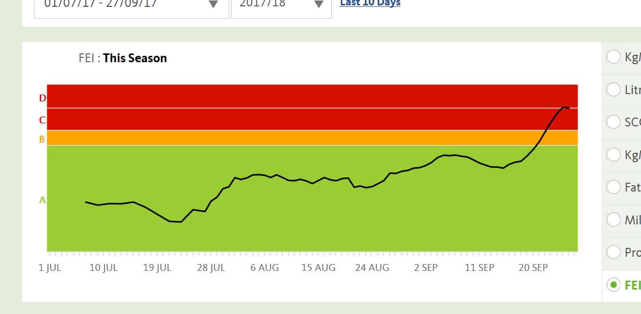

Slide 9
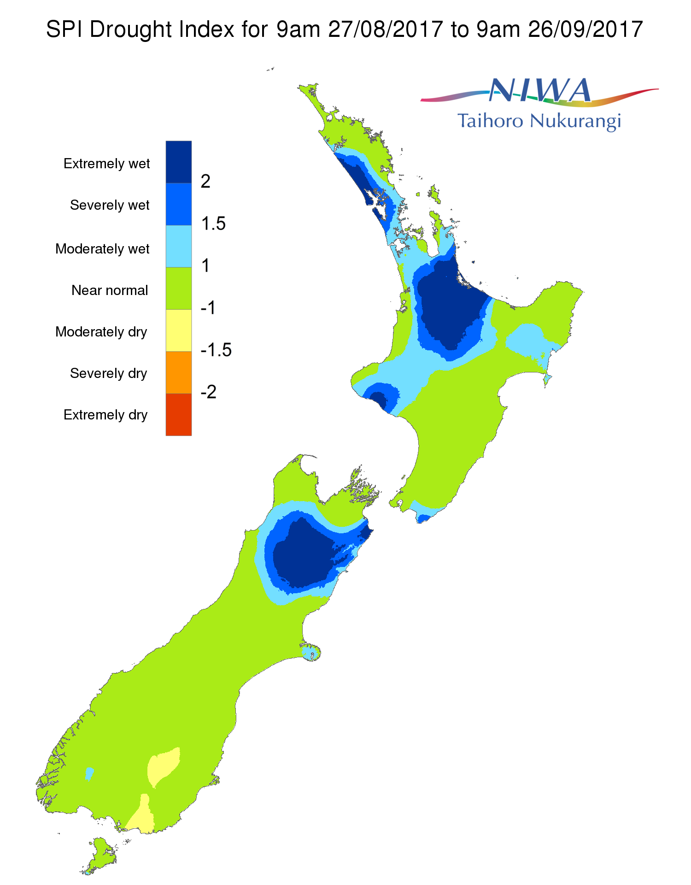
Our farm

Slide 10
What went wrong?
Good payout forecast
So maintained high stocking rate
Reasonable feed stocks on hand so didn’t buy more
Wet year (2x avg. rainfall) left paddocks damaged
Experience said: can’t have bad Summer, Autumn, Winter AND Spring right… the sun will come
Farm consultant’s advice: “don’t blink”

Slide 11
The Milk Production Optimiser incorporating Weather Dynamics and Economic Risk

Slide 12

Evaporation
Rainfall
Sunlight
Transpiration
Evaporation
potential
Temperature
Drainage

Slide 13
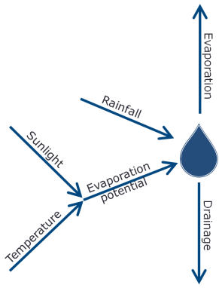

Growth
Fertiliser
Harvest
Transpiration
Feed
Nitrogen

Slide 14

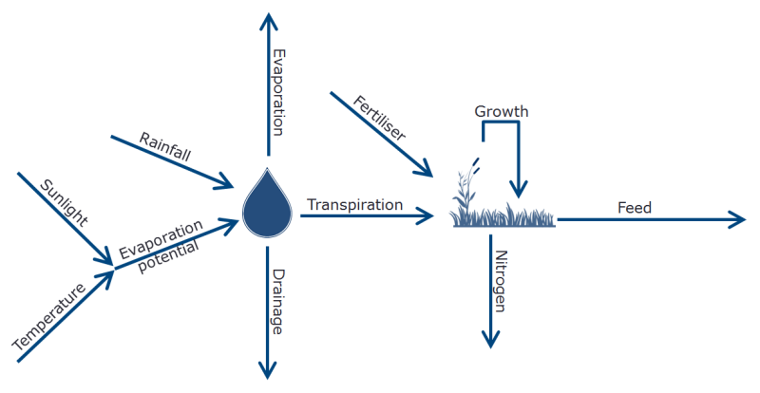
Buy
Harvest
Feed

Slide 15
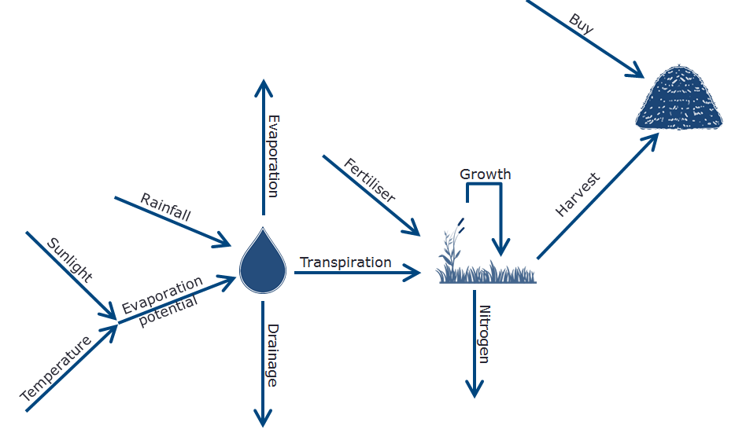
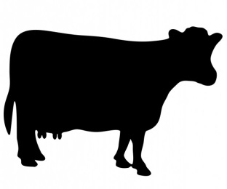
Feed
Feed
Feed
Feed
Dry
Milk
$
FGMP

Slide 16
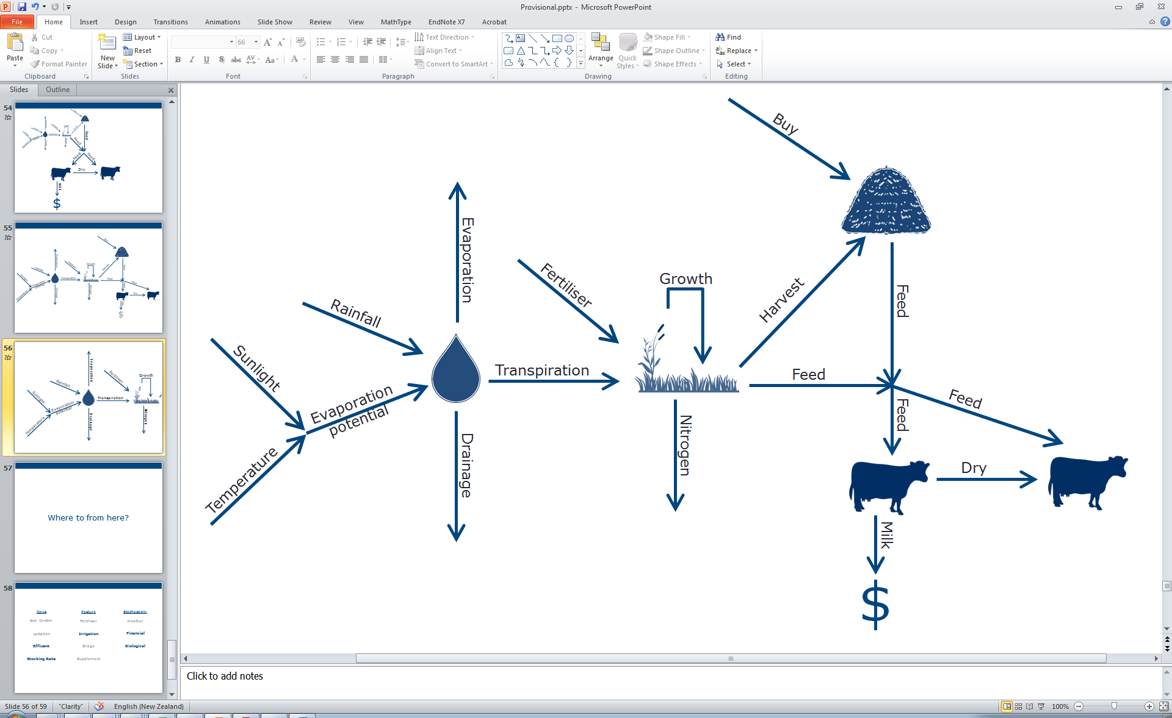
FGMP

Slide 17
Weather
Model
FGMP

Slide 18
Weather
Model
Plant
Model
FGMP

Slide 19
Weather
Model
Plant
Model
Production
Model
FGMP

Slide 20
Storage
Model
(Optional)
Weather
Model
Plant
Model
Production
Model
FGMP

Slide 21
Storage
Model
(Optional)
Weather
Model
Plant
Model
Production
Model
Price
Model
FGMP

Slide 22
Dowson-Farms A Case Study

Slide 23
Historical Weather Data

Slide 24
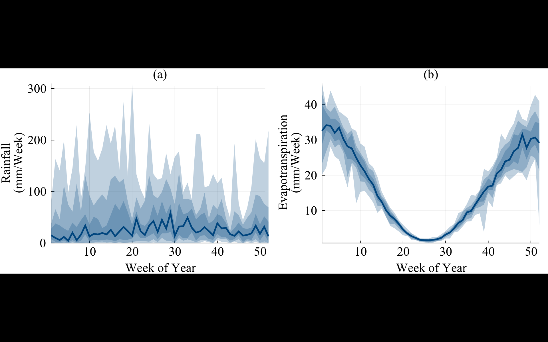

Slide 26
Forecasting The Milk Price

Slide 27
$8
1/9
$7
2/9
$6
3/9
$5
2/9
$4
1/9
T=1
…
T=24
T=25
…
T=51
T=52

Slide 28
Results

Slide 29
$8
1/9
$7
2/9
$6
3/9
$6
$5
2/9
$4
1/9
T=1
…
T=24
T=25
…
T=51
T=52

Slide 30
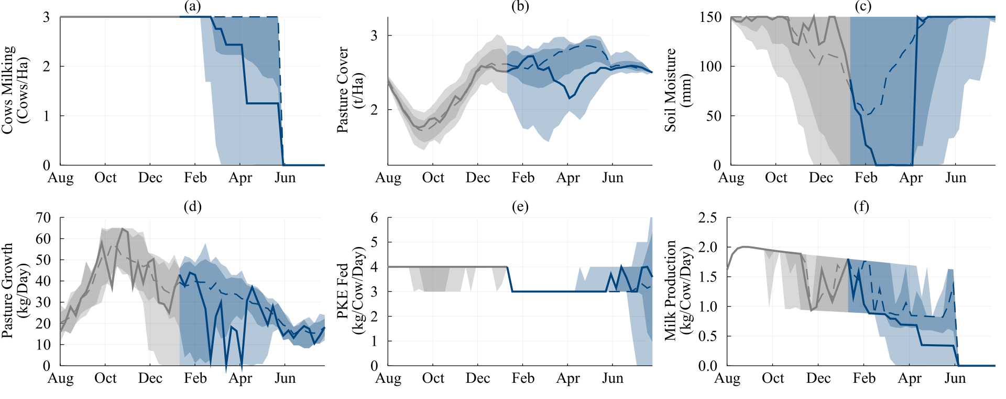
Low Price Scenarios

Slide 31
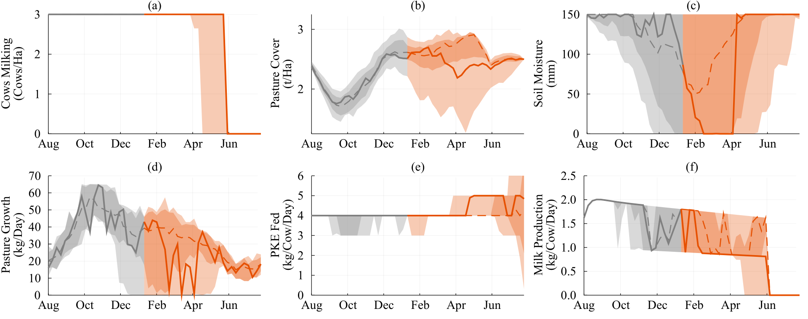
High Price Scenarios

Slide 32
Can we do better?

Slide 33
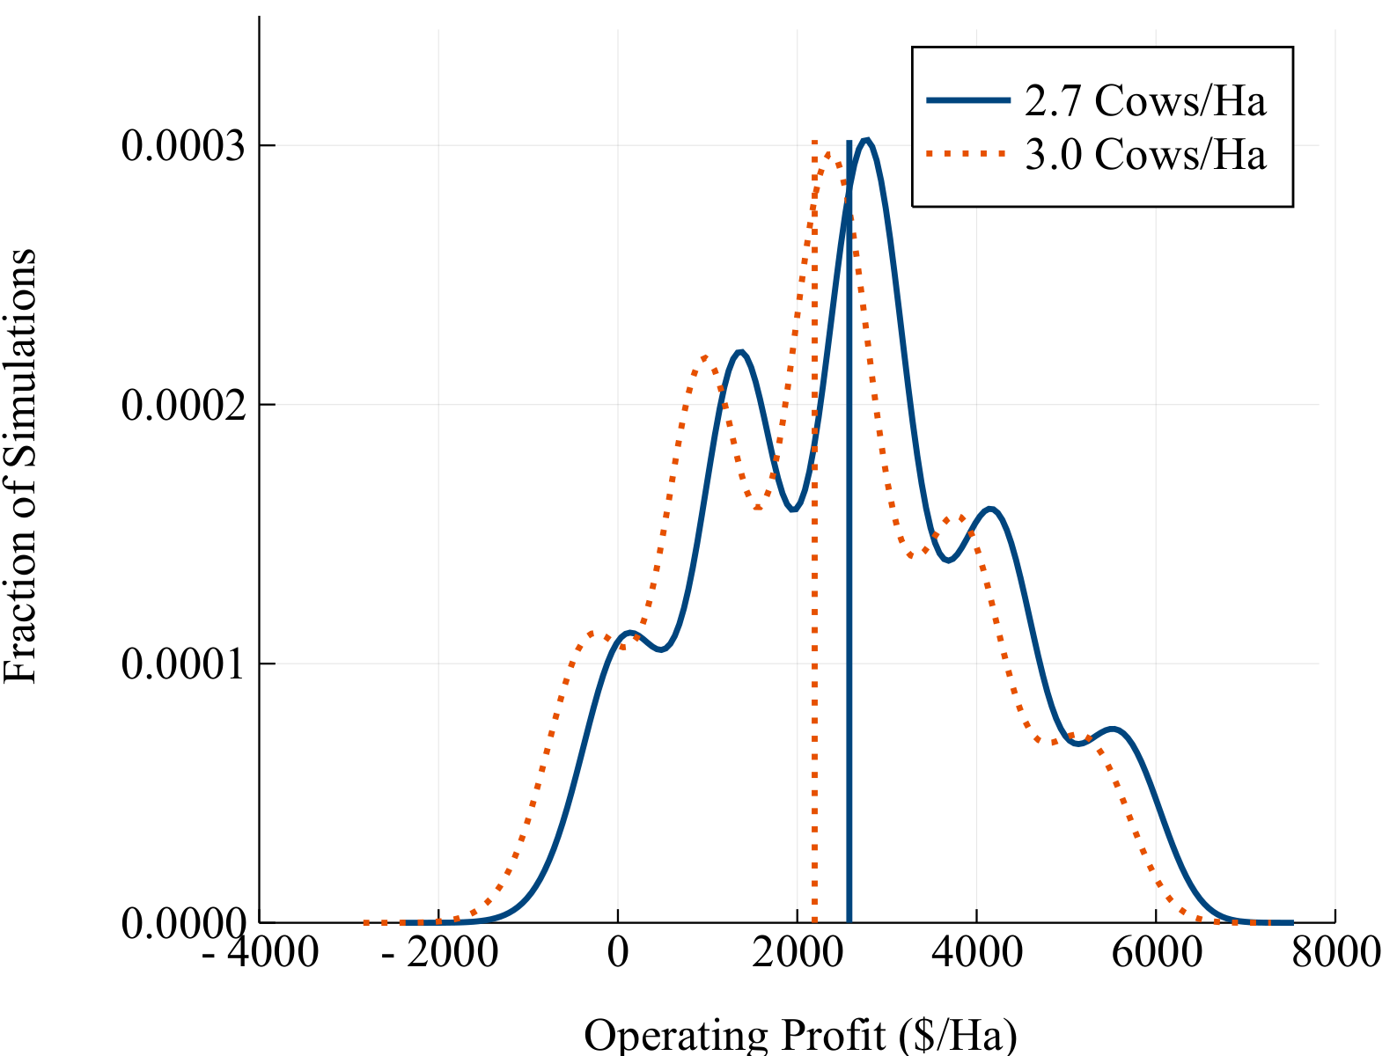
Lowering the Stocking Rate
+$386/Ha

Slide 34
What next?
A better price model
A better weather model
A better animal model
Milk Price Futures
Nitrogen
Ability to sell/buy stock
Sheep and Beef?
Cropping?

Slide 35
